Slide 1
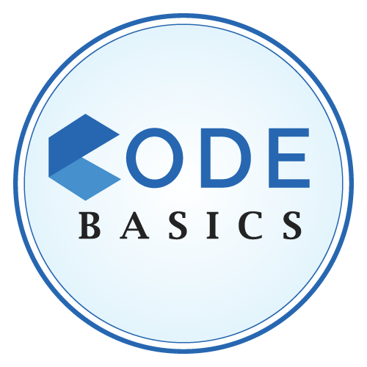


TELANGANA TOURIST ANALYSIS
ISHOLA SEMIU OLAWALE

Slide 2


INTRODUCTION
Telangana is one of India’s leading states, it is located in Southern region of India and has published its tourism data under its open data policy.
Telangana government wants to increase their revenue by improving administrative operations in the tourism sector.
The company has provided data of 3 years of both domestic and foreign visitors.

Slide 3
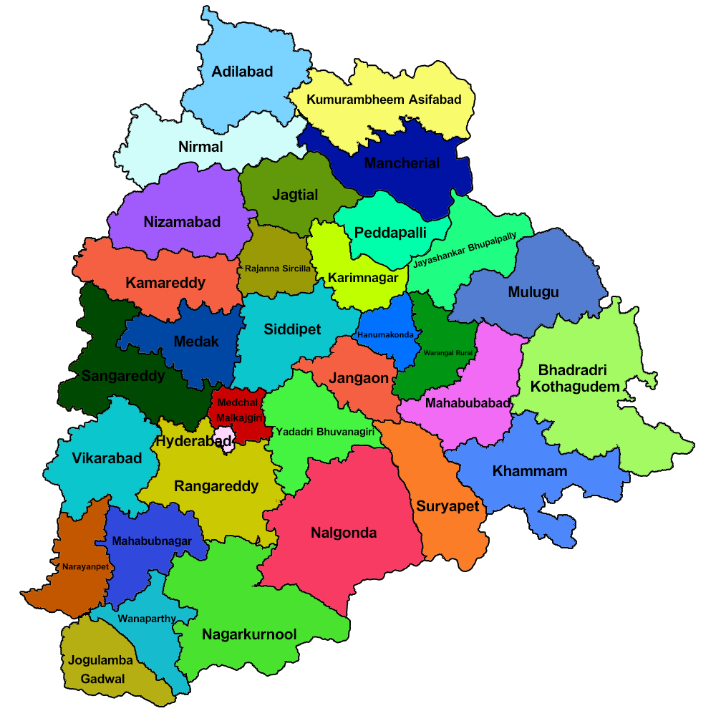
TELANGANA DISTRICTS

Slide 4
AIM OF THE PROJECT
Aim of this project is to find the patterns in the given data, do additional research, and give data-informed recommendations to the Telangana government which can be used to increase their revenue by improving administrative operations. Provides insights to some primary, secondary research questions and recommendation ideas.

Slide 5
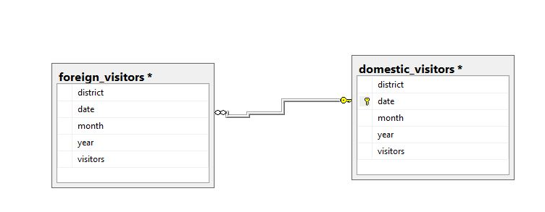
DATABASE RELTIONSHIP

Slide 6
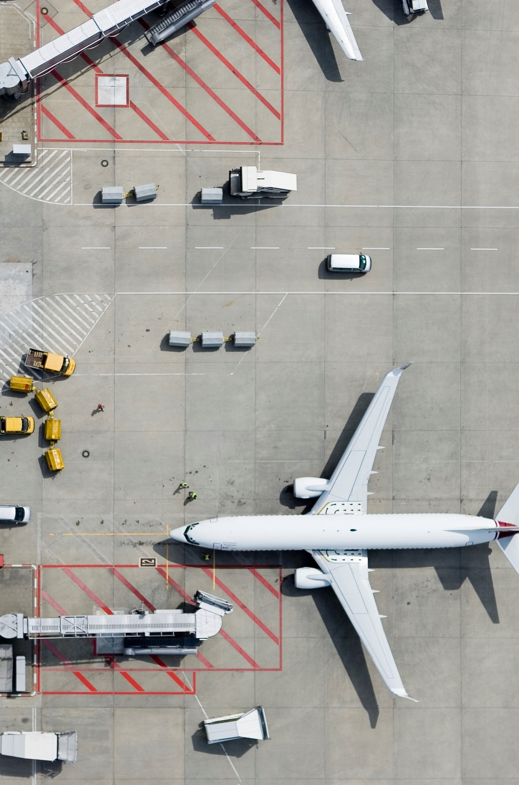
YEARLY VISITORS

Slide 7
TOTAL VISITATION BY YEAR

Slide 8
NO VISITORS DISTRICTS
There are some districts without visitors across the years:
Medchal
Ranga Reddy
Suryapet
Vikarabad

Slide 9

PRELIMINARY RESEARCH QUESTIONS

Slide 10
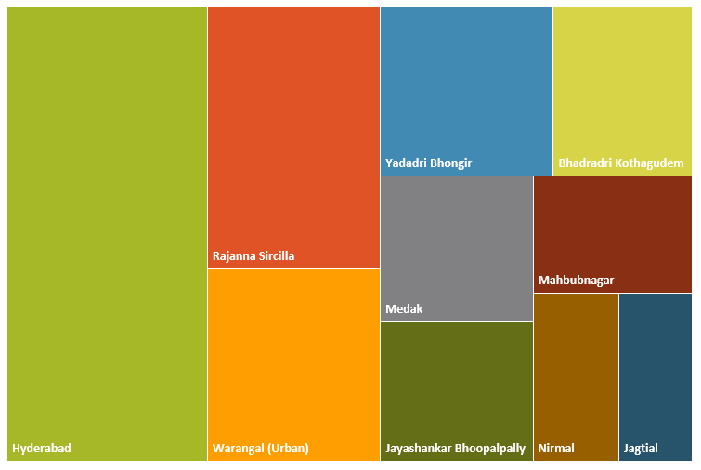
1. TOP 10 DISTRICTS THAT HAVE THE HIGHEST NUMBER OF DOMESTIC VISITORS OVERALL (2016 - 2019)
INSIGHTS: This shows the top 10 districts with high domestic visitors. Hyderabad has the highest which is far more than the sum of the next two consecutive. Therefore, Hyderabad is doing really well.

Slide 11
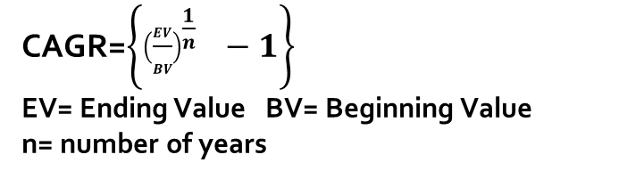
2. THE TOP 3 DISTRICTS BASED ON COMPOUNDED ANNUAL GROWTH RATE (CAGR) OF VISITORS BETWEEN (2016 - 2019)
CAGR=$\left\{{\left(\frac{EV}{BV}\right)}^{\frac{1}{n}} −1\right\}$
EV= Ending Value BV= Beginning Value
n= number of years
INSIGHTS:
CAGR is used to measure the performance over time in long run. Mancherial has the best performance followed by Warangal(Rural) and Bhadradri Kothagudem respectively. They have a very high CAGR their visitors have a high probability of increasing.

Slide 12
3. THE BOTTOM 3 DISTRICTS BASED ON COMPOUNDED ANNUAL GROWTH RATE (CAGR) OF VISITORS BETWEEN
(2016 - 2019)
INSIGHTS:
CAGR is used to measure the performance over time in long run. Karimnagar has the poorest performance followed by Nalgonda and Warangal(Urban) respectively. They have a very low CAGR their visitors have a high rate of decreasing in the long run.

Slide 13
4. WHAT ARE THE PEAK AND LOW SEASON MONTHS FOR HYDERABAD BASED ON THE DATA FROM 2016 TO 2019 FOR HYDERABAD DISTRICT
INSIGHTS:
People visits Hyderabad a lot in the month of June, this is due to:
the formation day of Telangana been celebrated on June 2 (Hyderabad been capital) and
the popular Bonalu festival starting in June ;
Due to high influx of people from October to January people tends to leave Hyderabad in February since there aren’t much celebrations

Slide 14
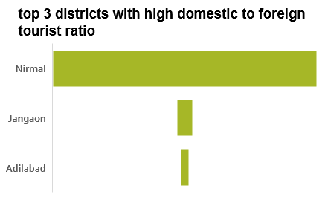
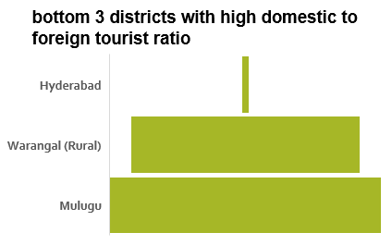
5. SHOW THE TOP & BOTTOM 3 DISTRICTS WITH HIGH DOMESTIC TO FOREIGN TOURIST RATIO
INSIGHTS:
Nirmal ha a very high ratio followed by Jangaon & Adilabad. They are attractive places to domestic visitors than to foreign visitors. These places has attractive places that the government can work on, such as: Kuntala water fall, Pochera waterfall & Kadam Dam. Mulugu, Warangal(Rural) & Hyderabad has the lowest ratios. Hyderabad is nice place as it is highly attracted to both domestic and foreigners.

Slide 15
6. ANNUAL GROWTH RATE (AGR) OF VISITORS BETWEEN (2016 - 2019) IN EACH DISTRICT WITH HIGH & LOW CAGR

Slide 16
CONTINUATION
6. ANNUAL GROWTH RATE (AGR) OF VISITORS BETWEEN (2016 - 2019) IN EACH DISTRICT WITH HIGH & LOW CAGR
INSIGHTS:
The districts with high CAGR values have high potential of having higher visitors in the coming years due to high annual growth rate in the first year. The government of Telangana has to improve the infrastructure in the districts and promote tourism.

Slide 17
SECONDARY RESEARCH QUESTIONS

Slide 18
6. LIST THE TOP & BOTTOM 5 DISTRICTS BASED ON 'POPULATION TO TOURIST FOOTFALL RATIO*' RATIO IN 2019
INSIGHTS:
The districts with low ratio have less visitors to its population. Kamareddy has a ratio approximately o which means that the districts is poorly attracted. States such as Rajanna Sircilla & Bhadradri Kothagudem has high ratio.
POPULATION DATA SOURCE: https://www.findeasy.in/districts-in-telangana/

Slide 19
7. WHAT WILL BE THE PROJECTED NUMBER OF DOMESTIC AND FOREIGN TOURISTS IN HYDERABAD IN 2025 BASED ON THE GROWTH RATE FROM PREVIOUS YEARS
INSIGHTS:
From the chart, Hyderabad domestic visitors keeps decreasing and makes it undeterminable for. This decrease can due to the district small size and the congestion across the states will be very high, this will makes houses expensive in the district. The projected number of foreign visitors for 2025 is 662,187. this is by the continuous increments in visitors.

Slide 20
8. ESTIMATE THE PROJECTED REVENUE FOR HYDERABAD IN 2025 BASED ON AVERAGE SPEND PER TOURIST
INSIGHTS:
From the chart, Hyderabad domestic visitors revenue keeps decreasing and makes it undeterminable for. The projected number of foreign visitors revenue for 2025 is ₹3,708,244,400 . This is by the continuous increments in visitors.

Slide 21
EXTRA. ROAD DENSITY OF DISTRICTS
INSIGHTS:
Road density is an important measure for infrastructure development. Places with high road density have high tourism rate. From the data, Warangal(urban), Hyderabad and Siddipet have high road density which will attract tourists.
DATA SOURCE: https://nriol.com/india-statistics/telangana/districts.asp, & https://data.telangana.gov.in/

Slide 22
9. WHICH DISTRICTS HAS THE HIGHEST POTENTIAL FOR TOURISM GROWTH AND WHAT ACTIONS GOVERNMENT CAN TAKE
DISTRICT | 2016 | 2017 | 2018 | 2019 | 2024 | 2025
Rajanna Sircilla | 2,176,801 | 11,919,347 | 10,834,231 | 16,832,897 | 38,314,881 | 42,603,198
Bhadradri Kothagudem | 889,030 | 4,094,317 | 3,799,878 | 12,817,737 | 28,469,834 | 32,019,002
Yadadri Bhongir | 1,728,600 | 7,001,728 | 13,673,378 | 4,489,374 | 16,443,352 | 17,938,749
Jayashankar Bhoopalpally | 243,486 | 1,831,592 | 16,896,464 | 662,575 | 15,517,920 | 17,150,134
Sangareddy | 778,000 | 2,823,450 | 2,269,900 | 4,553,160 | 9,607,882 | 10,685,075
INSIGHTS:
Districts with highest predicted tourists in 2025 are: Rajanna Sircilla, Bhadradri Kothagudem & Yadadri. These districts have the highest potential for tourism growth, they have high annual growth rate in one between (2016-2019).

Slide 23
10. CULTURAL / CORPORATE EVENTS TO BOOST TOURISM
a. Which month(s)?
INSIGHTS:
The top 6 months for organizing events are highlighted for both domestic and foreign. December, February and January are best months to organize events for all. Also, June is a month where events can be organized to boost tourism as people are much there during the period for the celebration Telangana formation.

Slide 24
10. CULTURAL / CORPORATE EVENTS TO BOOST TOURISM
b. What kind of events the government can conduct?
The government can support and promote the following events :
Festival | Month | HOW
Bathukamma festival | September-October | Show case Telangana culture through programs or competitions and allow both domestic and foreign talents be dramatized.
Bonalu festival | June-August | Show case Telangana culture through programs or competitions and allow both domestic and foreign talents be dramatized.
Holi festival | March | Also know as festival of colors. The government can provide financial assistance
Sankranti | January | The government can create a talent show during its celebration whereby both foreign and domestic visitors are allowed to participate
Telangana state creation | June | Show case Telangana culture through programs or competitions and allow both domestic and foreign talents be dramatized.
Diwali | October-November | The government can decorates the whole environment to signify a festival of lights and organize attractive programs.
Kurumurthy swamy Jantara | November | The government can create a talent show during its celebration whereby both foreign and domestic visitors are allowed to participate
Komuravelli Mallikarijuna Swamy | January-April | Show case Telangana culture through programs or competitions and allow both domestic and foreign talents be dramatized.
Numaish | January- February | Show case Telangana culture and produce through programs or competitions and allow both domestic and foreign talents be dramatized.

Slide 25
10. CULTURAL / CORPORATE EVENTS TO BOOST TOURISM
b. What kind of events the government can conduct?
Also, Telangana tourism government can create a tour guide whereby people from different places across Telangana, India and other countries can be guided across the state. This will enthusiast people to join as it will be a means to know more and meet new people.
c. Which districts?

Slide 26
11. CAN HYDERABAD EMULATE THE DUBAI MODEL
Hyderabad been the smallest districts in terms of land mass in Telangana. It is also referred to as the capital district.
Hyderabad can emulate the Dubai model (making itself a business hub and enjoys massive business tourism).
Regardless of Hyderabad small size, it has the highest domestic and foreign visitors and the predicted number of foreign visitors keeps increasing.
To emulates this Dubai model, Hyderabad needs to improve its road density, infrastructures and creates events that can attracts tourists.

Slide 27
12. OTHER RECOMMENDATIONS THAT CAN BOOST THE TELANGANA TOURISM, PARTICULARLY HYDERABAD
Improve the road leading districts together across Telangana
Reduce the amount charged per tourists as this will bring in more people especially for the foreigners.
Lakes and attractive places in Telangana should be treated and make cleaned always such as Hussain Saga lake in Hyderabad, Manjeera.
Hyderabad should work on reducing housing costs. This will increase both foreigners and domestic visitors.
Hyderabad needs to work on ways to reduce traffic across the district ad higher visitors counts will be experienced in the near future.

Slide 28
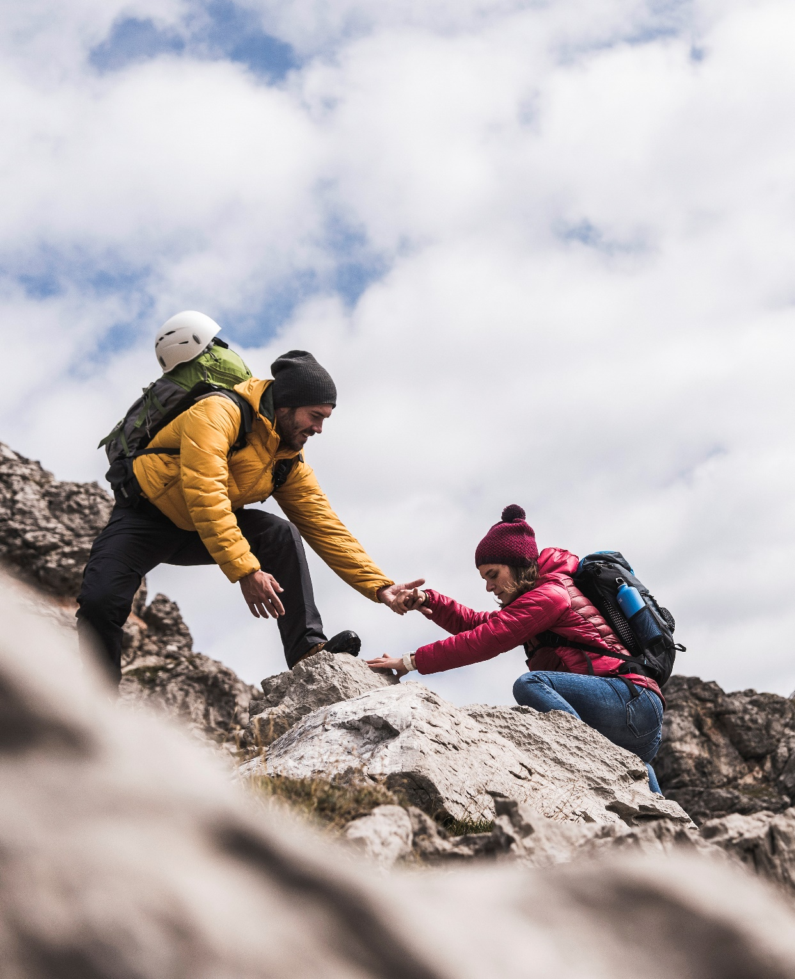
Thank You
walewest98@gmail.com

